Slide 1
Sherlock Community Meeting
Sherlock filesystems, partitions and limits
Sherlock/SLURM user tips
February 7, 2018

Slide 2
1.0 vs. 2.0
Sherlock 1.0 | Sherlock 2.0
Intel Xeon v3 with 16 CPUs, 8 cores (Haswell) per node | Intel Xeon v4 with 20 CPUs, 10 cores (Broadwell) per node
1U R630 server | 1/2U C6320 server in a chassis
56G FDR Infiniband | 100G EDR Infiniband
200G SSD and 500G Hard Disk | 200G SSD
64G RAM as base server | 128G RAM as base server
Uses Centos 6.x | Uses Centos 7.x

Slide 3
Sherlock Partitions
normal
hns
gpu
dev
bigmem (1.5 TB - 3.0 TB)
your PI’s own nodes
owners
QOS long (--qos=long, the only QOS needed) jobs >2 days <7 days
What extra partitions can I run on?
scontrol show partition | egrep -B1 "AllowGroups=.*$(id -gn $user).*" | awk -F= '/PartitionName/ {print $2}'

Slide 4
School of Humanities and Sciences Users
If your department is in H&S use hns, hns_gpu partitions in addition to normal, owners, etc. Most H&S PIs have been added.
Sherlock 1- 12 nodes, 10 standard, 1 bigmem (1.5 TB) 1 GPU (8 Tesla K80s)
Sherlock 2- 24 nodes, 2 large mem nodes 512 RAM, 22 standard CPU nodes (with 20 CPUs 128 GB RAM)
Submit to both partitions at once if your jobs have similar requirements
#SBATCH –p hns,normal

Slide 5
Sherlock Limits: If you ever see- “Batch job submission failed: Job violates accounting/QOS policy” :(
Queue name | Default time limit per job | Max runtime per job | Max cores per user | Default memory per core | Max jobs running per user | Max jobs in queue per user | Purpose
normal | 2 hr | 48 hrs | 512 | 4 GB | 256 | 3000 | normal production
dev | 1 hr | 2 hrs | 2 | 4 GB | 2 | 4 | interactive and/or development
bigmem | 2 hr | 16 hrs | 32 | 48 GB | 1 | 20 | large memory 48 GB/core, 32 cores/node
gpu | 2 hr | 48 hrs | 32 | 16 GB | 16 | 300 | 16 GPU/node, 16 cores/node, 16 GB/core
long | 2 hr | 7 days | 256 | 16 GB | 16 | 64 | queue for long-running jobs, user can use up to 16 jobs and/or 128 cores use "--qos=long" option.

Slide 6
View Sherlock Limits
View the various partition limits with the sacctmgr command-
sacctmgr show qos format=Name,GrpTRES,MaxTRESPerUser,MaxJobsPerUser,MaxSubmitJobs,MaxWall
Name GrpTRES MaxTRESPU MaxJobsPU MaxSubmit MaxWall
---------- ------------- ------------- --------- --------- -----------
normal cpu=128 1500 2-00:00:00
dev cpu=2,mem=8G 2 02:00:00
long cpu=128 cpu=32 16 32 7-00:00:00
bigmem node=1 1 16 1-00:00:00
gpu gres/gpu=4 256 2-00:00:00
owners cpu=2048 3000 2-00:00:00
owner cpu=99999 3000 7-00:00:00

Slide 7
Sherlock Filesystems
Home and PI home, backed up, snapshotted and replicated offsite
$HOME 15 GB
$PI_HOME 1 TB
Fast Lustre parallel filesystem, your jobs should write/read here (6 month purge policy)
$SCRATCH 20 TB
$PI_SCRATCH 30 TB
$LOCAL_SCRATCH 200GB
even faster, but gets deleted at the end of your job
http://www.sherlock.stanford.edu/docs/user-guide/storage/filesystems/

Slide 8
Sherlock Filesystems- Oak
$OAK is an option for unlimited long term storage at $41.67 per 10TB / month (or $50 per TB / year)
https://srcc.stanford.edu/oak-storage

Slide 9
How to ask for resources, CPUs, RAM, nodes (servers), time
Only ask for what you need, your jobs will pend for less time and your Fairshare factor will be better if you do.
Profile jobs in dev, run tools like sacct, htop, ps, time, python profilers
1. sdev
2. run your code on the command line, ml load python -> python mycode.py &
3. htop, top
4. Look at memory and CPU % use
5. Find the node your job is running on with squeue, then ssh to it, run htop, top, ps

Slide 10
Estimating resources requirements, htop
[mpiercy@sherlock-ln03 login_node ~/TF]$ sbatch TF_mnist.sbatch
Submitted batch job 20244339
[mpiercy@sherlock-ln03 login_node ~/TF]$ squeue -u $USER
JOBID PARTITION NAME USER ST TIME NODES NODELIST(REASON)
20244339 hns_gpu TF_mnist mpiercy R 0:04 1 gpu-27-21
[mpiercy@sherlock-ln03 login_node ~/TF]$ ssh mpiercy@gpu-27-21
Can ssh to the server only of you have a job running on it.
use nvidia-smi -l 1 for GPU nodes

Slide 11
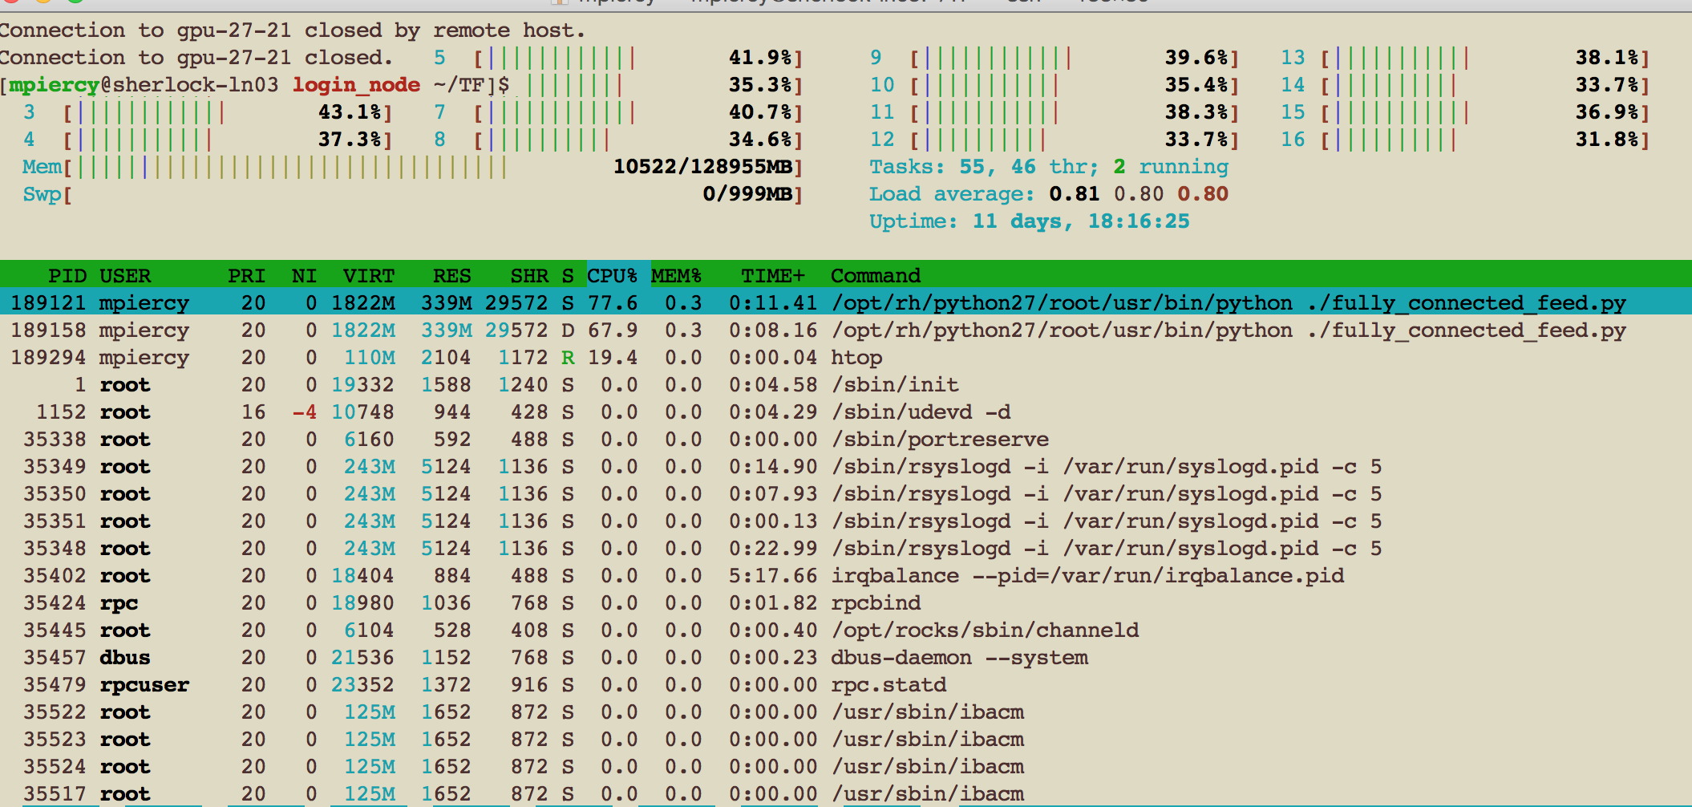
Look at your job’s usage with htop

Slide 12
sstat- monitor resource usage as a job runs
sstat --format JobID,NTasks,nodelist,MaxRSS,MaxVMSize,AveRSS,AveVMSize 20267805
JobID NTasks Nodelist MaxRSS MaxVMSize AveRSS AveVMSize
------------ -------- -------------------- ---------- ---------- ---------- ----------
20267805.0 1 gpu-27-21 393953K 1912732K 393017K 1912732K
Compare these values to what you requested in your sbatch file or srun command

Slide 13
Estimate your batch job’s resource requirements
sacct -o reqmem,maxrss,averss,elapsed,alloccpus -j 3413279
ReqMem MaxRSS AveRSS Elapsed AllocCpus
---------- ---------- ---------- ---------------------
16000Mc 1-20:54:49 4
16000Mc 4771852K 4603220K 1-20:54:49 4
The first line is the parent job
You've requested 16GB per core, i.e. a total of 64 GB (4x16GB, everything in one node)
Your job has used a maximum of 4771852K i.e. 4.7 GB per core
You've requested more than 10 GB too much memory per core i.e. about 50 GB too much in total
So, ask for less memory for this kind of jobs, e.g. --mem-per-cpu=8GB

Slide 14
Estimate your batch job’s resource requirements
sacct -o reqmem,maxrss,averss,elapsed -j 20222292
ReqMem MaxRSS AveRSS Elapsed
---------- ---------- ---------- ----------
1024Mn 00:00:10
1024Mn 579K 579K 00:00:10
1024Mn 90K 90K 00:00:10
1024Mn 524K 524K 00:00:05
reqmem = memory that you asked from SLURM. If it has type Mn, it is per node in MB, if Mc, then it is MB per core
maxrss = maximum amount of memory used at any time by any process in that job. This applies directly for serial jobs. For parallel jobs you need to multiply with the number of cores (max 16 or 24 as this is reported only for that node that used the most memory) averss = the average memory used per process (or core). To get the total memory need, multiply this with number of cores elapsed = time it took to run your job

Slide 15
Estimate your batch job’s resource requirements
sacct -j 6811562 --format JobID,JobName,Partition,User,AllocCPUS,NNodes,Elapsed,TotalCPU,State,MaxVMSize,MaxRSS,ReqMem
JobID JobName Partition User AllocCPUS NNodes Elapsed TotalCPU State MaxVMSize MaxRSS ReqMem
------------ ---------- ---------- --------- ---------- -------- ---------- ---------- ---------- ---------- ---------- ----------
6811562 OpenMP_ex+ normal mpiercy 12 1 00:00:02 00:00.794 COMPLETED 40Gn
6811562.bat+ batch 12 1 00:00:02 00:00.125 COMPLETED 177624K 0 40Gn
6811562.ext+ extern 12 1 00:00:03 00:00.002 COMPLETED 107904K 0 40Gn
6811562.0 hello2 12 1 00:00:00 00:00.666 COMPLETED 313156K 876K 40Gn
The above shows JobID 6811562 completed successfully, using 313MB of memory, but requested 40GB/node. In this case you would reduce your memory requests for future jobs of this type to something much less - perhaps something in the range of 5-8GB. The job also took only 3 seconds, so the default time of 2 hours is more than enough.

Slide 16
More info
http://www.sherlock.stanford.edu/docs/
Our Group-
https://srcc.stanford.edu/
Questions-
srcc-support@stanford.edu
Slides-
https://srcc.stanford.edu/sherlock-community-meeting-slides

